Slide 1
[Organisation] · PHASE B
Value Stream Definition
Seven streams, 38 stages, and where value is lost in each
7 streams · 38 stages · 13 carrying no measure
0.1 — Draft · May 2027 · Owner: Business Domain Architect

Slide 2
METHOD
A stream is not a process
Four rules. The second removes stages rather than adding them, and it is the reason this definition is shorter than the process catalogue.
A value stream is triggered by a stakeholder, not by an internal event
Every stream here names the party whose need starts it. Where a stream starts with an internal trigger it is a process, and it belongs inside a stage.
Each stage must accrue value, or it is not a stage
The test is whether the triggering stakeholder is better off after it than before. Handoffs, approvals and queues fail this test and are recorded as waste, not as stages.
Stages are enabled by capabilities, not performed by systems
The capability reference is what connects this deliverable to the capability map. A stage with no capability behind it is a gap in one or the other.
Measures are taken at the stage, not at the stream
An end-to-end cycle time hides where the time goes. Thirteen of 38 stages have no measure at all, which is itself the finding.
The metamodel holds the seven streams and a stage count for each. It does not hold the stages, which is what this deliverable adds.

Slide 3
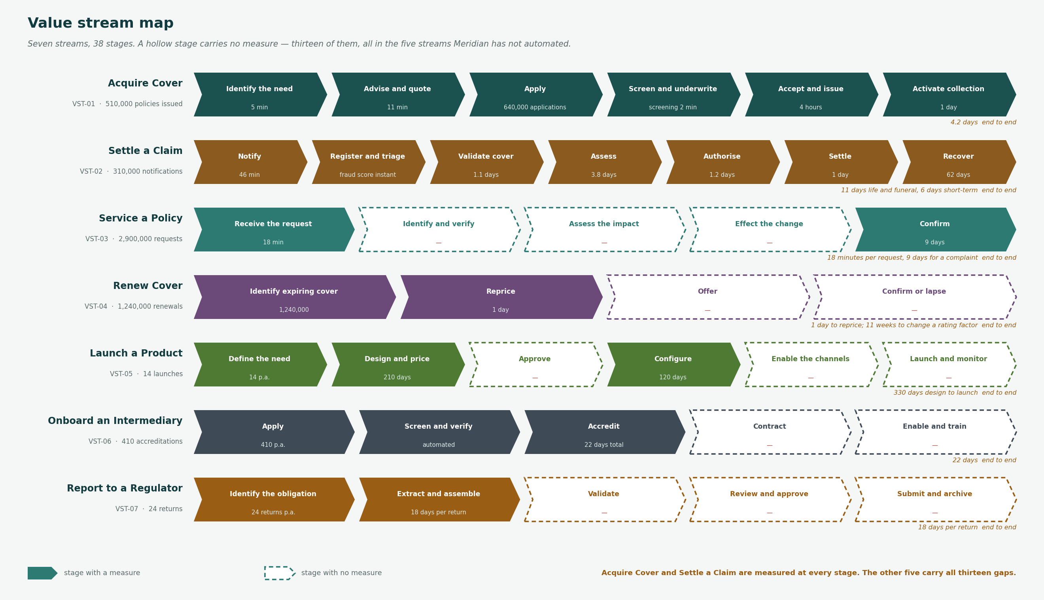
VALUE STREAM MAP
Seven streams, 38 stages
A hollow stage carries no measure. All thirteen sit in the five streams [Organisation] has not automated.

Slide 4
STREAMS
The seven streams
Each triggered by a stakeholder, not by an internal event. The last column is where value leaves the stream.
Ref
Stream
Triggered by
Now
Target
Principal loss of value
VST-01
Acquire Cover
Prospective policyholder
4.2 days
Same day for simple risks
Of 2.1m quotations, 510,000 become policies. The stream loses three quarters of what enters it, and [Organisation] cannot say at which stage.
VST-02
Settle a Claim
Claimant
11 days life and funeral, 6 days short-term
2 days funeral, 4 days short-term
Assessment is 3.8 days and manual. Leakage of 4 to 6% is R0.9bn to R1.3bn, and the recovery stage runs at 62 days.
VST-03
Service a Policy
Policyholder
18 minutes per request, 9 days for a complaint
8 minutes; 4 days
An agent opens 2.6 systems per request because the customer is held in four masters. Identify-and-verify is repeated on every contact.
VST-04
Renew Cover
Policyholder
1 day to reprice; 11 weeks to change a rating factor
1 day; 1 week
The repricing runs fine. Changing what it prices on takes eleven weeks because rating factors sit inside the policy platform.
VST-05
Launch a Product
Line of business
330 days design to launch
120 days
Design is 210 days and configuration a further 120, because 11 of 18 products are coded rather than configured.
VST-06
Onboard an Intermediary
Broker or partner
22 days
5 days
Screening is automated and accreditation is not. The intermediary waits on a manual credential check that could be a service call.
VST-07
Report to a Regulator
Regulator
18 days per return
8 days
Assembly is manual because lineage lives in spreadsheets. Twelve per cent of conduct outcome measures are reportable from source.
Acquire Cover loses three quarters of what enters it. No stage records why, which is the largest unexplained loss of value in the business.

Slide 5
THE GAP
Thirteen stages carry no measure
Every one sits in a stream [Organisation] has not automated. Acquire Cover and Settle a Claim are measured at every stage.
VST-03
Identify and verify
Repeated on every contact, across four masters. 2.6 systems opened per request.
VST-05
Launch and monitor
Experience monitoring is quarterly and manual.
VST-03
Assess the impact
Where a change affects rating, the answer requires an underwriter.
VST-06
Contract
No recorded pain, and no measure either
VST-03
Effect the change
Applied per master. A change of address is made up to four times.
VST-06
Enable and train
Each embedded partner requires a bespoke integration before they can transact.
VST-04
Offer
No recorded pain, and no measure either
VST-07
Validate
Reconciliation breaks are resolved by the person who assembled it.
VST-04
Confirm or lapse
Lapse reasons are not captured, so retention cannot be analysed.
VST-07
Review and approve
No recorded pain, and no measure either
VST-05
Approve
No recorded pain, and no measure either
VST-07
Submit and archive
Evidence of what was submitted, and on what basis, is not held in one place.
VST-05
Enable the channels
No recorded pain, and no measure either
Identify-and-verify happens 2.9 million times a year, has no measure and no automation, and appears in three of the seven streams.

Slide 6
CYCLE TIME
Where the time actually goes
The longest stages are low-volume and therefore invisible in operational reporting. Attention has gone to the high-volume stages instead.
Design and price a product
210 days
VST-05
Manual end to end. The longest single stage in any stream.
Configure a product
120 days
VST-05
11 of 18 products are coded rather than configured, so this stage is a software release.
Pursue recovery
62 days
VST-02
Reinsurance recovery tracked in a spreadsheet outside the claims system.
Accredit an intermediary
22 days
VST-06
Manual credential checks against the FSCA register, one at a time.
Manage arrears
14 days
VST-03
Partly automated, and the customer is in four masters.
Assess a claim
3.8 days
VST-02
Manual, without prior claims history. This is where leakage occurs.
Product design and configuration together are 330 days. That is the whole of the Launch a Product stream, and none of it is measured after the first two stages.

Slide 7
FINDINGS
What the definition shows
Thirteen of 38 stages have no measure at all
All thirteen sit in Service a Policy, Renew Cover, Launch a Product, Onboard an Intermediary and Report to a Regulator. Acquire Cover and Settle a Claim are measured at every stage.
The two streams [Organisation] measures well are the two it has automated. The others are unmeasured because nothing records them, not because they are unimportant.
The longest stages are the ones nobody automated
Product design at 210 days, configuration at 120, recovery at 62, accreditation at 22.
Attention has gone to the high-volume stages, which is rational for cost and wrong for cycle time. The slow stages are low-volume and therefore invisible in operational reporting.
Acquire Cover loses three quarters of what enters it
2.1 million quotations become 510,000 policies. No stage records why the other 1.59 million did not convert.
This is the single largest unexplained loss of value in the business, and it cannot be analysed until the stream records a reason at each exit.
Identify-and-verify is repeated on every contact
Stage 2 of Service a Policy has no measure, no automation and happens 2.9 million times a year across four masters.
It is the clearest operational case for the identity hub, and it appears in three of the seven streams.
Two stages exist only because of the systems beneath them
Settle a Claim stage 6 waits for an overnight batch; Launch a Product stage 4 is a software release.
Neither accrues value to the triggering stakeholder. Both fail the test in the method and should disappear rather than be improved.
Two stages exist only because of the systems beneath them. Neither accrues value, and both should disappear rather than be improved.

